Slide 1
Analysis of User Behavior for Twitter Posts on Hadoop
- Abhilash Saj

Slide 2
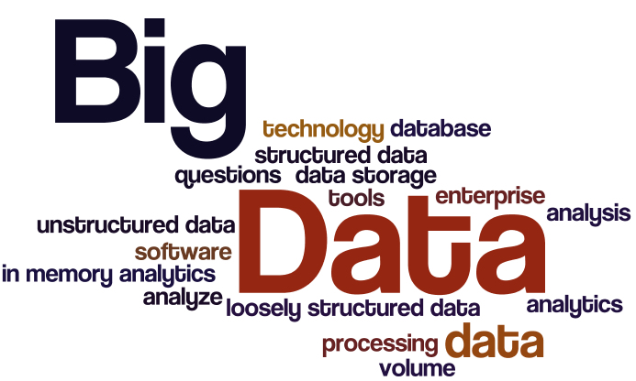
INTRODUCTION – BIG DATA
Collection of large datasets
Structured and unstructured data
Difficult to process and analyze

Slide 3
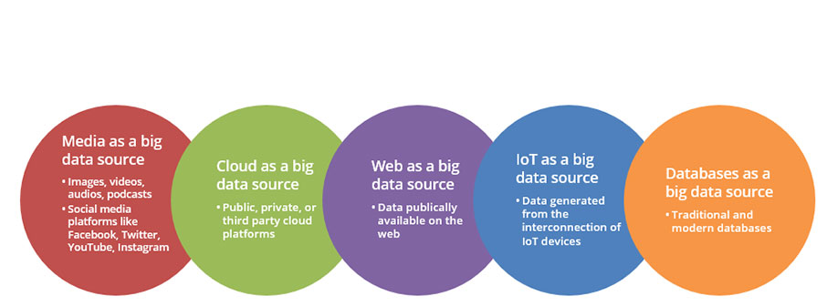
SOURCES OF BIG DATA

Slide 4
Hadoop
Hadoop is a flexible and open source implementation for analyzing large datasets using MapReduce.
There are various emerging technologies such as Apache Pig, Hive, Sqoop, HBase, Zookeeper, and Flume that can be used to improve the performance of basic Hadoop MapReduce framework.

Slide 5
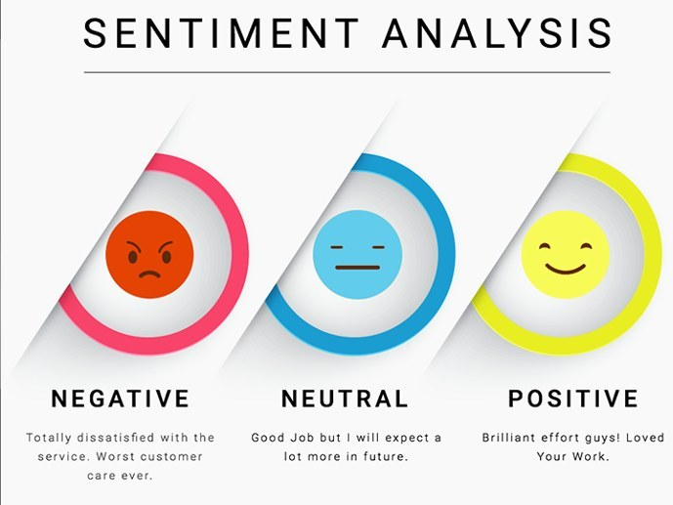

Slide 6
Project
Tweet analysis for user behavior.
Tweets are available in JSON format which is to be converted into a structured data.
Output how users behave for particular topic in certain country and city.

Slide 7
Challenges with social media data
Grammar and Spellings
Trustworthiness
Format
Language

Slide 8
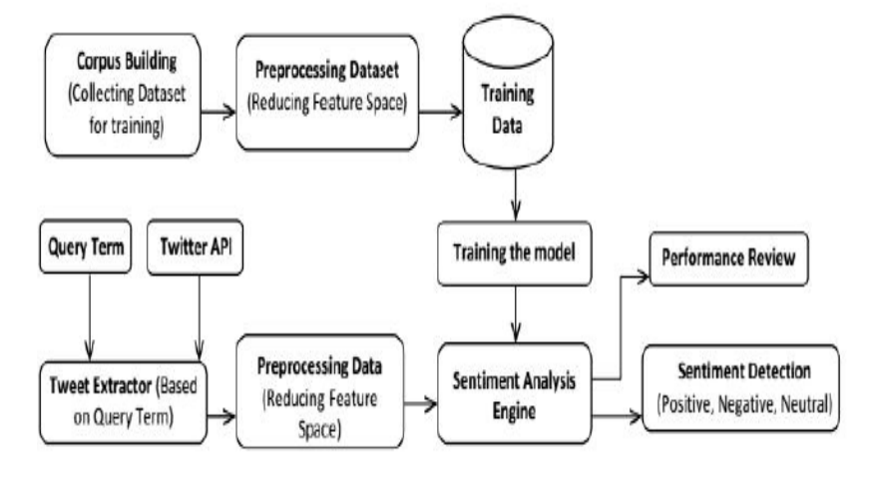
Existing Work

Slide 9
Explanation
Firstly, training data collected from various sources is subjected to preprocessing to eliminate features which do not contribute to polarity detection.
This training data is fed into sentiment analysis engine for classifying test data.
Secondly, the input query term is used to fetch data from social media for which polarity is to be detected.
The sentiment analysis engine contains Naive Bayes classification algorithm which consults training data to calculate probabilities and predict the sentiment for given query term.
Demerits with existing system are that it is only used for sentiment analysis of uses i.e. positive, negative or neutral.

Slide 10
Proposed system
The proposed system focuses on the behavioral of user according to various tweets that whether the user is in drifting mode, positive, or negative.
Also the proposed system focuses on the general behavior of user country wise or city wise in context of particular topic.

